Slide 1
I can LTEven… [MVP]
How I service providered and you can too!

Slide 2
I don’t want a million talks about ”how I hacked this thing”, I want to see people building things too.
- Bruce Potter
(probably)

Slide 3
Relevant Background Information
I’ve done some 4G/5G things
LTE and It’s Collective Insecurity – Wall of Sheep – DC24
SPARROW – bouncing messages across towers – DC 29
Site surveys/Port Scanning of devices
Tested 4G networks in a previous life
I have a strong burning desire to be my own terrible service provider
srsRAN hacking
I love weird, strange, esoteric, unloved protocols and systems
I cope with my social anxiety by submitting to CFPs and speaking publicly

Slide 4

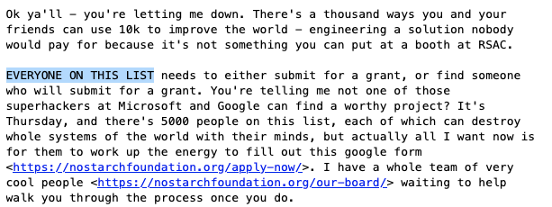
The challenge
Notes:
https://seclists.org/dailydave/2021/q2/1
Wait a minute, I have an idea.

Slide 5

Notes:
So in order to understand what my thoughts were, we’re going to have to back in time a few years. When I was looking around on the internet for something else and stumbled into a technology.

Slide 6
complejidad, ¡adiós! Remedial LTE discussion
COMPLICATED
MANY MUCH ACRONYM
NOT FUN
PUT TO SLEEP
HOW MAKE NOT SO BORING?
WORDS WORDS WORDS
Notes:
So this is a slide, with some additional annotations, of what a mobile packet core looks like, notably this is a 4G one, but 5G is pretty similar, even if they’ve changed the names of everything and put it on Kubernetes.
The idea is that your phone, which is called a UE, will connect to the a cell tower, that tower is called an eNodeB. The eNodeB is somewhat entangled with a few other pieces of gear, but essentially you uses that thing called MME as it’s identity and AuthN provider, while the stuff labeled SGW/PGW is essentially a VPN tunneling device that will eventually route your traffic out to the internet. Which service providers call “the PDN”.
That is why there is a cat picture there. Because it’s the internet.
Anyways, what isn’t on this slide, and what I really don’t want to get into in this presentation, is the fact that all of these pieces of gear use weird protocols you’ve never heard of. Like S1AP, or SCTP, or DIAMETER, or GTP-U and GTP-C.
None of these types of listening services should ever be on the internet, and if this equipment is mostly in the hands of big giant telephone companies, we should find any on the internet? Right?
However the best hypothesis is one that is proven wrong, so using some uncle jeff computers I scanned the internet for some of these protocols , and what do you know, I found plenty.

Slide 7
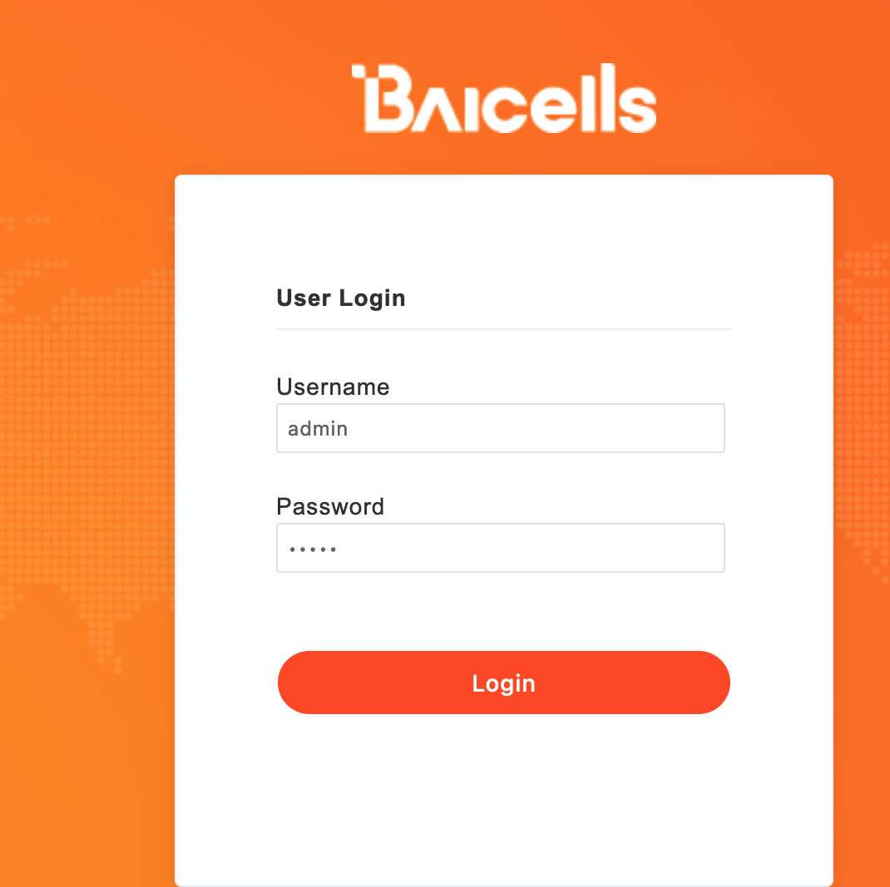
Well, this was unexpected
While researching 5G stuff, decided to scan the Internet for hosts that ”speak” 4G/5G. SCTP + GTP, that sort of stuff. See previous presentations.
https://github.com/nobletrout/sctpscan
Ran into a lot expensive stuff (Ericsson), but also ran into a lot of stuff that looked like this
Web management ports on an “MME” isn’t normally a thing
Notes:
So I expected to find an ericcsson or cisco thing here or there. The type of gear that I couldn’t afford and shouldn’t poke at. What I didn’t expect was to run into things that I hadn’t heard of, like this thing here.
WTF is a Baicell I wondered? And why is it HTTP cleartext and looks like a router from 2005? So I did what anyone would do, I googled it, and stumbled backwards into a whole world I somehow didn’t know about until then.

Slide 8
WTF is this thing, and what does it mean?
Baicell is part of a (not so) new set of products to support the concept of “Private LTE”. There are other competing vendors as well.
CBRS – Citizens Broadband Radio Service
3.5 Ghz carved out for us to do, essentially, mobile broadband
Not well advertised
Pretty “cheap” to get into
Notes:
In 2015 the feds carved out a piece of 3.5ghz spectrum so that everyday people like you and me can create our own “PrivateLTE” networks.
https://www.fcc.gov/wireless/bureau-divisions/mobility-division/35-ghz-band/35-ghz-band-overview

Slide 9

So about that Dave Aitel challenge
I submitted the form to the hacker initiative
They sent me money
I built a private LTE network
Here’s how I did it
And where I want to go next
Remove complexity to enable more people to attempt this

Slide 10
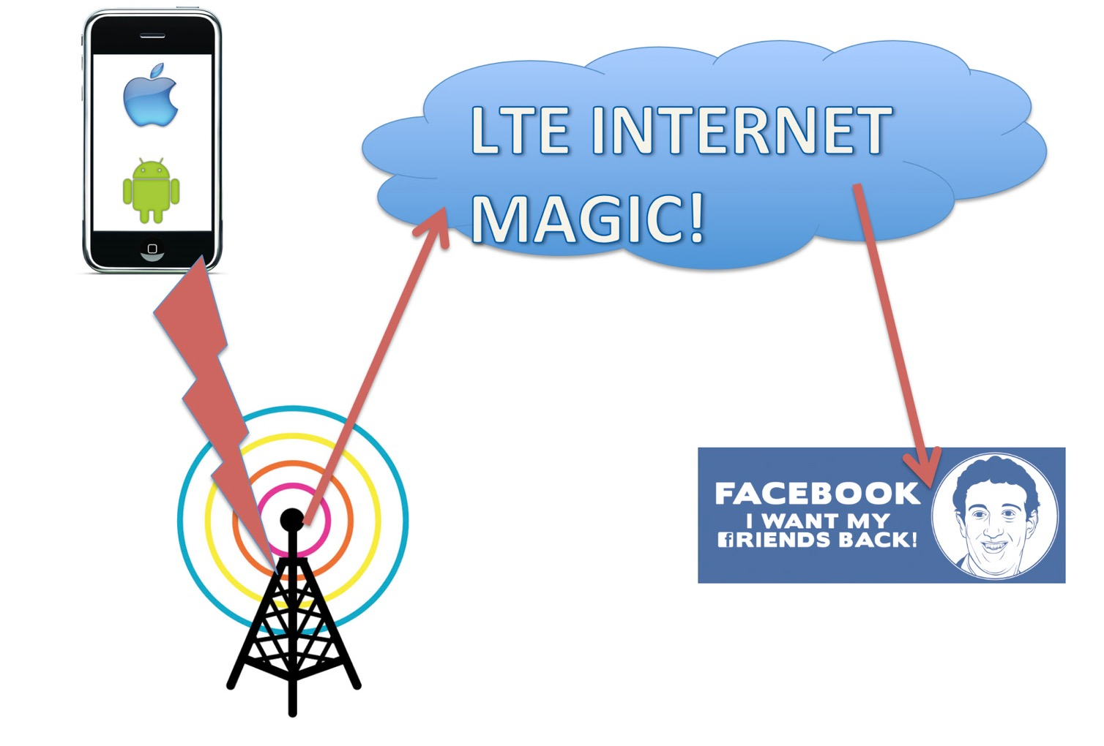



Desired End State
Sure I guess I need SIM Card?
Just give me web management thing
Just connect me to internet
Notes:
Let’s start from the beginning
You are going to want to try to make one of these work.
So you can drive your own phone network be a badass service provider.
You’re going to need at the least: 1) A phone
2) Sim cards?
3) Something that looks like a cellphone tower?
4) Ability to surf the internet

Slide 11

From zero to hero
CBRS (feds)
Licensing (feds)
Equipment Purchases (money)
Supported phones (money)
Subscriptions (2023)
Next leveling

Slide 12
CBRS Tiers
CBRS is broken into three parts
We are interested in the last tier.
Everything for setting up your own LTE network is about avoiding interfering with everyone else.
Tier 1
Tier 2
Tier 3
Incumbents
Preferred Access Lines (PAL)
The rest of us
Service Providers
Gubberment
Me
You
Marty McFly
People with more money

Slide 13

Spectrum Considerations - CBRS
CBRS is not the wild west
You must be a Certified Product Installer (CPI)
You must take a training class
You must get the certificate (it’s actually PKI!)
Then you can get spectrum “assigned” to your enodeB, I mean CBSD, no cell tower. The thing with antennas sticking out of it.
Device (tower) needs spectrum assigned to it
To get access to a SAS you must be a CPI
To become a CPI you must take a $600 class and get digital certificate
Spectrum is granted by Spectrum Access System (SAS)

Slide 14
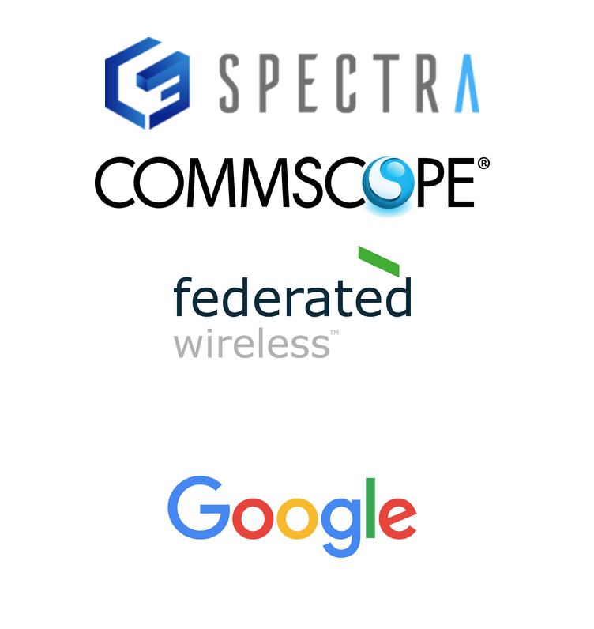
First hurdle, how do I get certified?
Start with the WinnForum CBRS standards
https://cbrs.wirelessinnovation.org/cpi-training-program
Bottom line, one of these vendors on right
I went with google because no human contact needed.
Training takes about 6 hours
You get digital certificate in a day or so
The training will teach you about all sorts of boring stuff, like azimuths, above ground level measuring, etc

Slide 15

What gear should I get?
You need at least 3 things
eNodeB (cell tower) [Nova430i from Baicell]
UE (phone) [Pixel 4]
SIM Cards [From Baicell to work with cloudcore]
Optional
LTE – ethernet bridges
Antenna extenders
OnGo Alliance Certified Equipment
Anything listed there should work, includes iphones and android stuff
Make sure it’s unlocked!
Notes:
I went with a baicell Nova430i (i – internal antenna) for eNodeB
https://ongoalliance.org/certification/fcc-authorized-end-user/

Slide 16
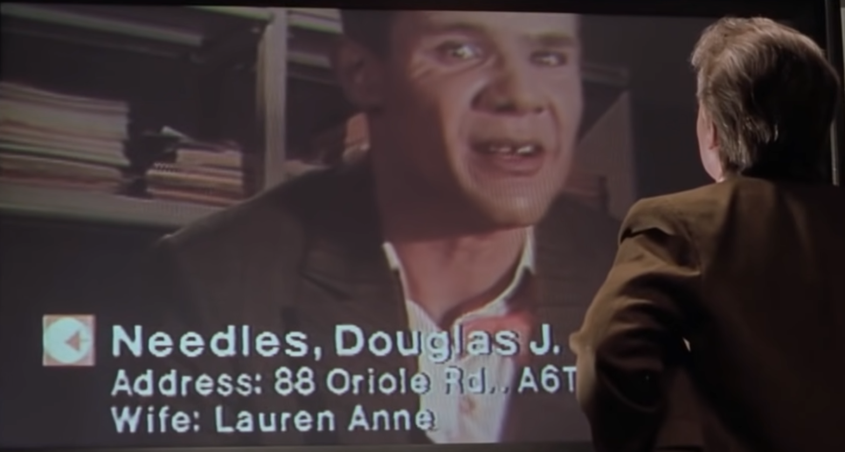
How do I buy gear like this?
It’s easiest if you incorporate
Make an LLC [legal zoom or figure it out]
Register a domain, get some email working
Look like a semi serious business person
Helps with some later steps too
Find a Reseller
I went with double radius, but there’s plenty to choose from

Slide 17
Infrastructure! Use other people’s computers
Notes:
Most of the complexity of LTE/5G is the ”packet core”, a scary, horrible place full of acronym soup designed by telephone companies to be for telephone companies.
Don’t let them win. Baicell, and I’m sure others, now provide a full “packet core” that leaves you with just a management console in the cloud to handle SIM card registration, tower management, CPE equipment management. It isn’t the best, but it isn’t weird and strange.
For privilege of having this complexity removed for you, Baicell will charge you $1/UE(phone) per month.
This is a highly affordable solution to remove this level of complexity.

Slide 18
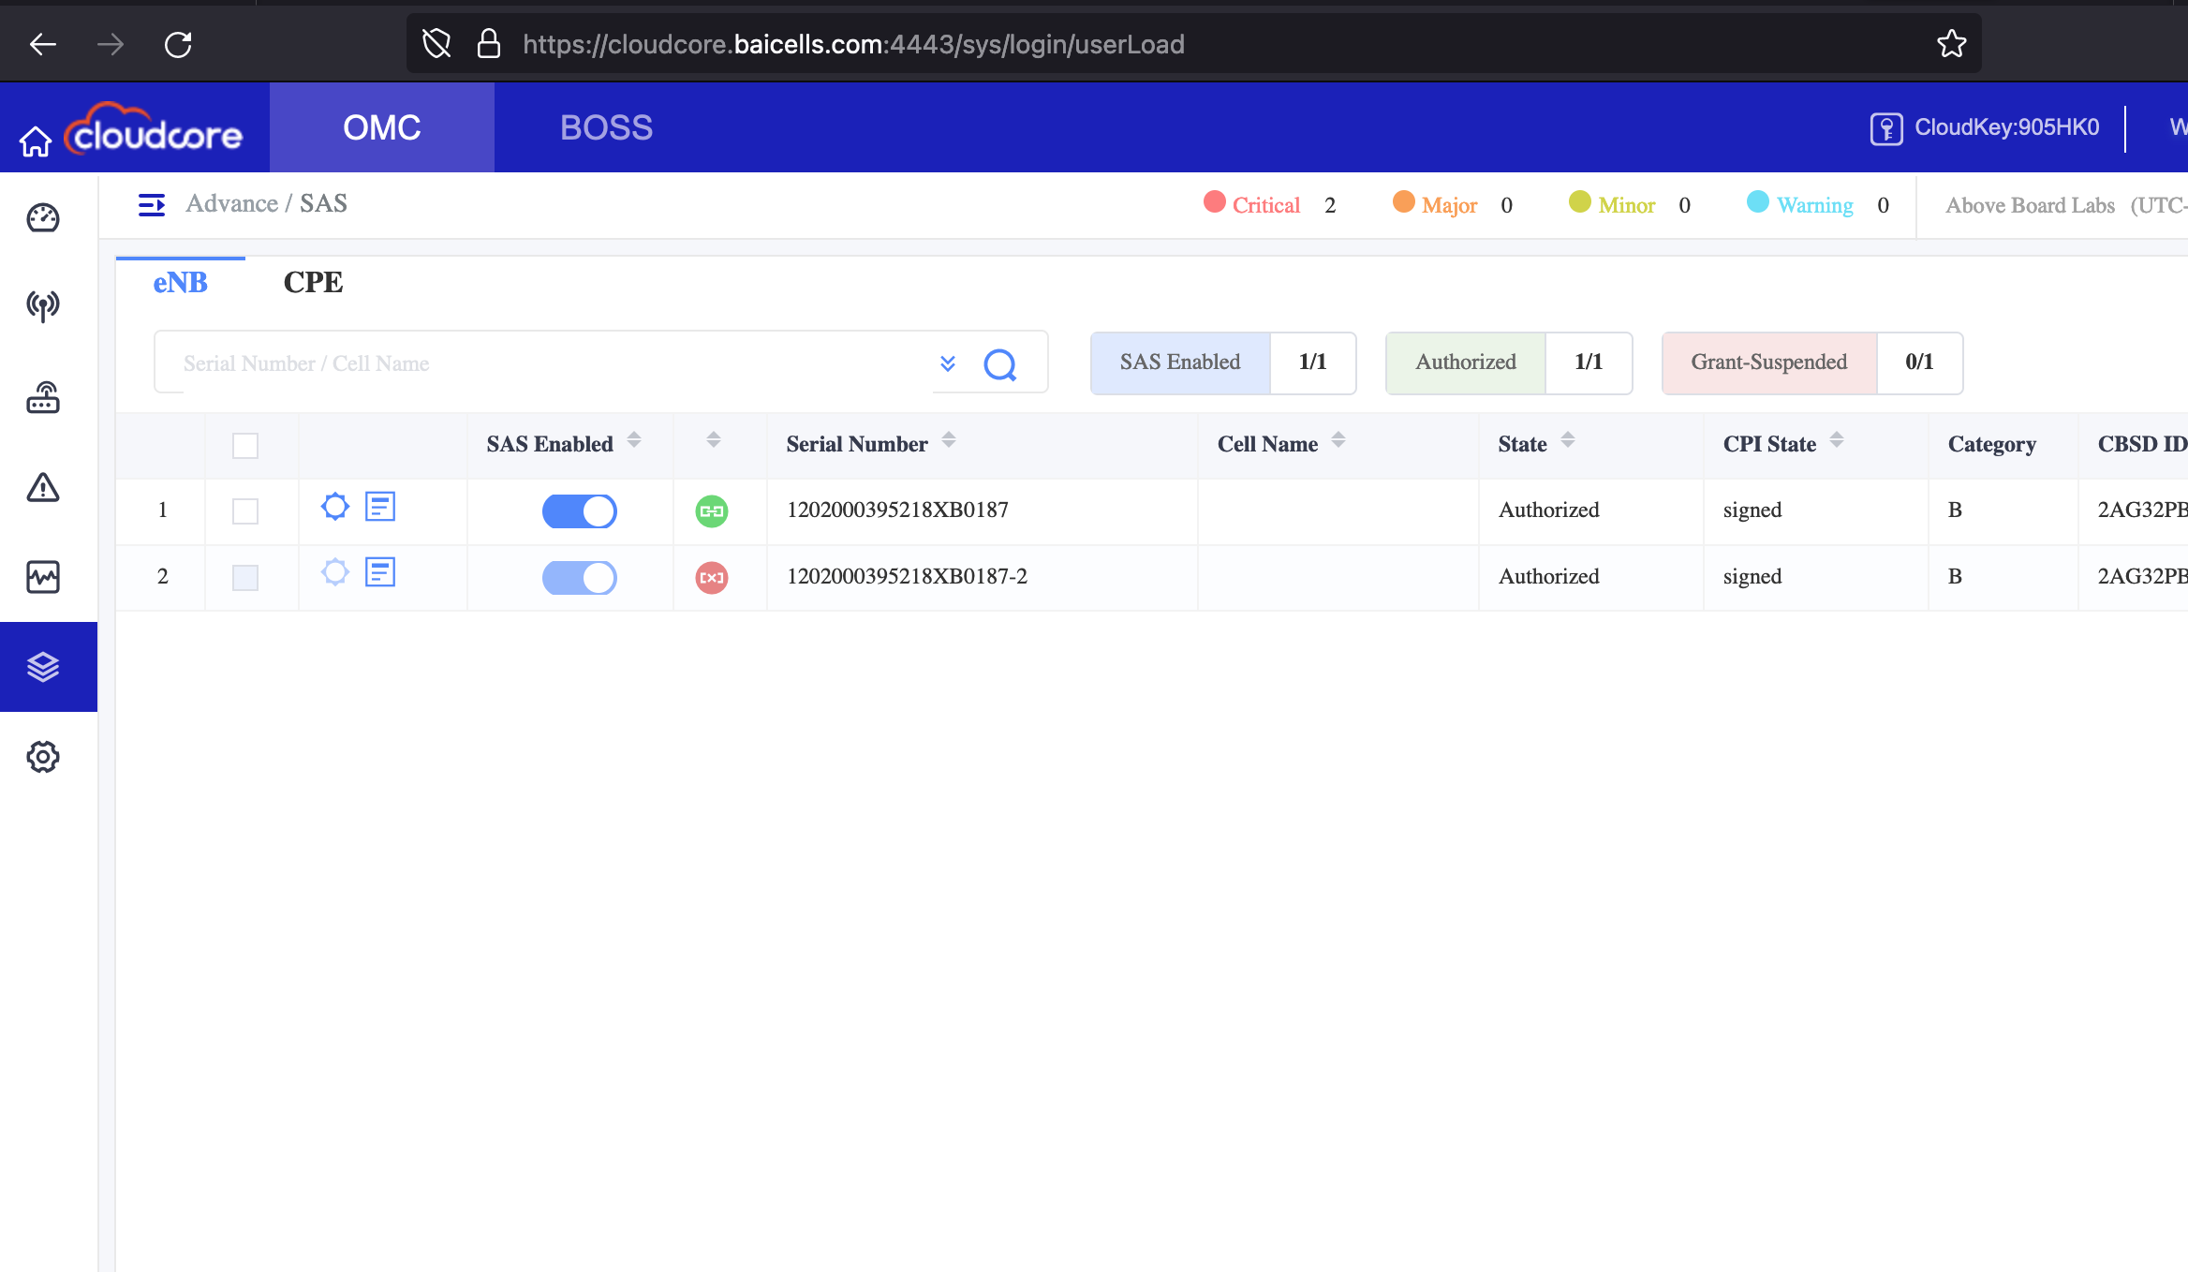

Slide 19
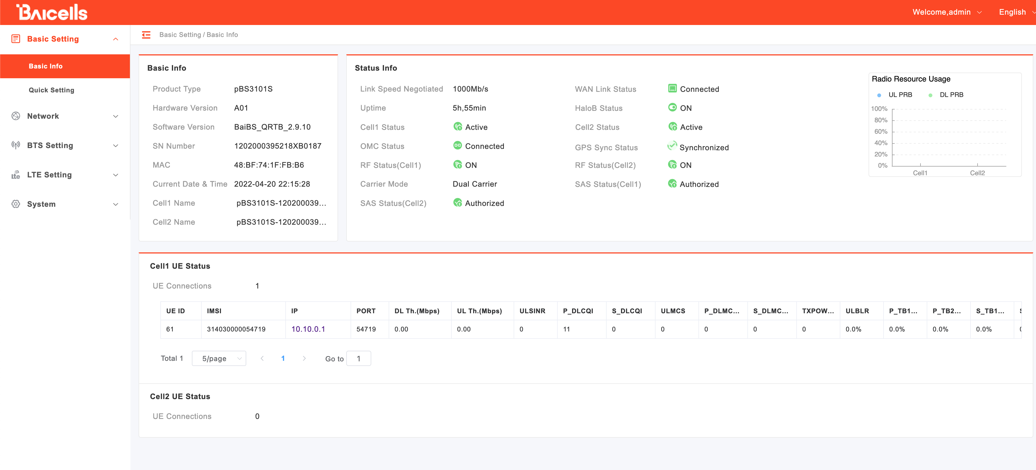

Slide 20
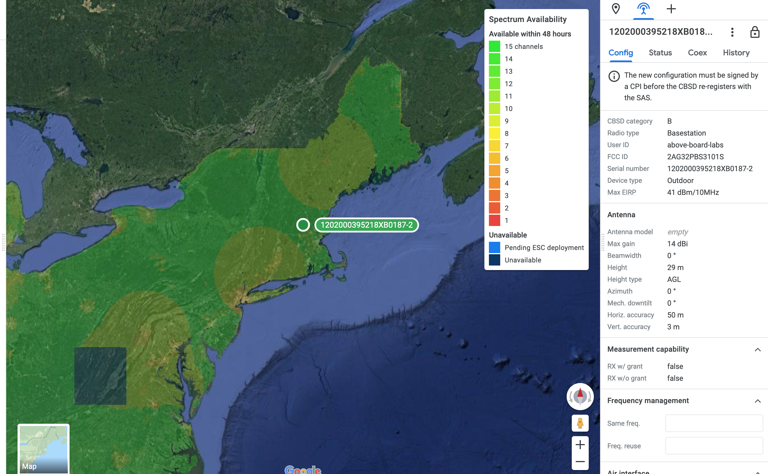
Infrastructure! Using Google’s computers!
Notes:
Spectrum assignment needs to be managed by a SAS. Part of the reality of getting access to the CBRS means that you need to enslave your tower to the will behemoths like Google, that will assign what spectrum and power parameters your tower can use.
Google’s SAS service costs about $13 per device per month.
If you don’t like google there are some other solutions to.
This is where being a “business entity” is really important, because they send you a bill that you have to pay with a check.

Slide 21
Rabbit hole stuff: DIY Packet Core
Create your own packet core
Make your own packet core with magma
OpenSource “packet core” solution
You will need “programmable SIM cards”
(if you figure out how to eSIM please tell me)
This is not an easy next step
But it would be really cool to save $2/mo

Slide 22
Rabbit hole stuff: Hack and Research
You now have the core underpinnings of a cool lab
BladeRF
SRSRan
More info with beers
No transmit, just receive
If you decide to transmit, that’s on you. Use chicken wire?
I’m not the airwaves police
Use VOIP Providers to provide cheap calling and SMS
These networks are data only
Voip.ms

Slide 23
Rabbit hole stuff: Community wireless
Tell the cable company to get lost
Not everyone needs 1 gigabit link, but you can definitely share it with 256 of your closest friends
Read the TOC’s? Or don’t. I’m not the internet police.
Reach out to me, I’d like to help people get internet access for cheaper.

Slide 24
TL;DR
Get a Certified Product Installer training and certificate for $600
Buy your CBRS LTE Gear from someone like Baicell
Register your devices with a SAS Provider (like Google)
Register your devices with a cloud managed packet core
Activate SIM card
Have LTE network

Slide 25

Thanks to
Find me:
@nobletrout@infosec.exchange
nobletrout [@ ]gmail.com
You can call me Chuck, it’s cool.
The Hacker Initiative (https://hackerinitiative.org/)
Boston Security Meetup
Shmoo Group
Resources
https://www.google.com/get/spectrumdatabase/sas/
https://www.coursera.org/learn/google-cbrs-cpi-training
https://blinqnetworks.com
https://na.baicells.com/
https://www.srslte.com/
https://www.gsma.com/services/esimdiscovery-smdp/
https://github.com/nobletrout/plaintext_LTE/blob/main/IM_TOO_YOUNG_TO_DIE.md
Feds
https://magma.github.io/magma/docs/next/basics/prerequisites

